Slide 1

Non-Rigid NeRF with Depth-Supvervision
Chang Luo, Robin Falter
Technische Universität München
30. November 2022
Notes:
Welcome everyone
To the presentation of our project Non-Rigid NeRF wiht depth supvervision

Slide 2
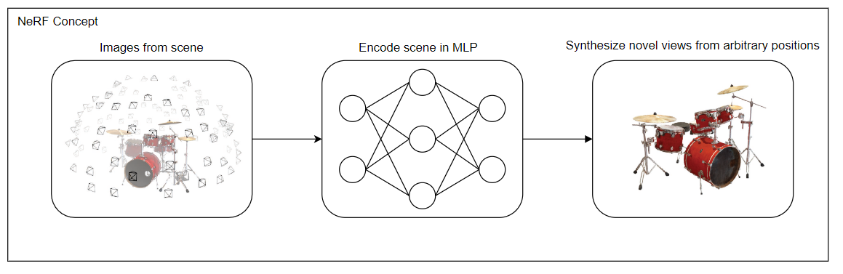

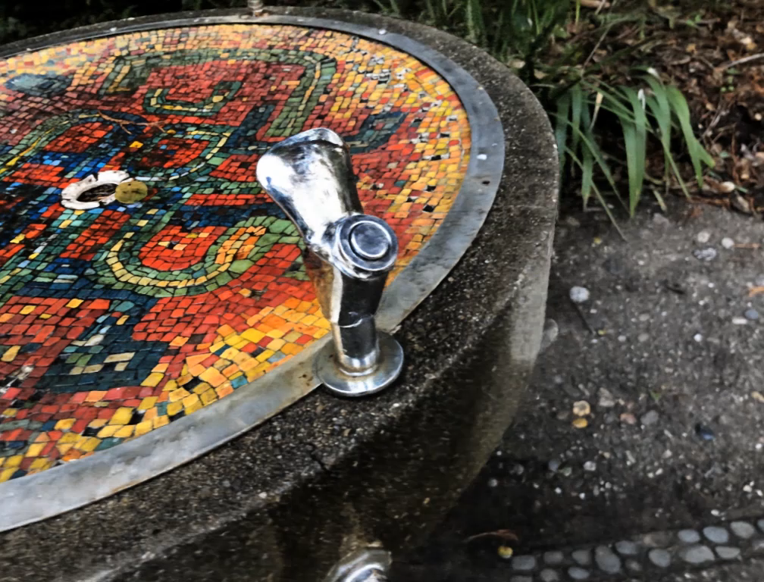
Introduction
Notes:
Introduction
Lets jump right into the presentattion and I start with the problem setting
Imagine you are a drummer and have taken a couple of images from you instrument but not from that one specific viewing angle from which you want to have an image from
Now you are looking for a method that can create novel view from arbitrary positions
Thats exactly what nerf does
NeRF is a combination of deep learning and image rendering techniques that can synthesize novel views from arbitrary positions
Below two examples of renderings from an optimized model

Slide 3
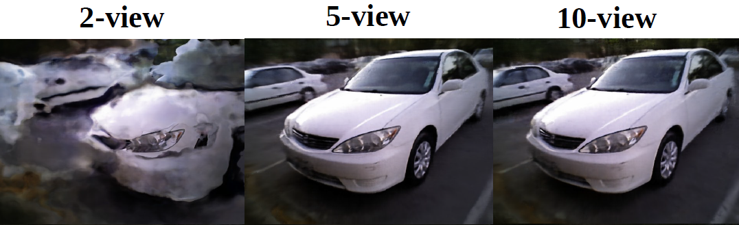
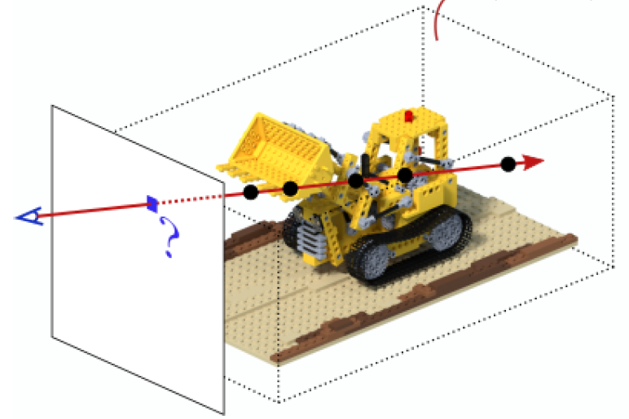

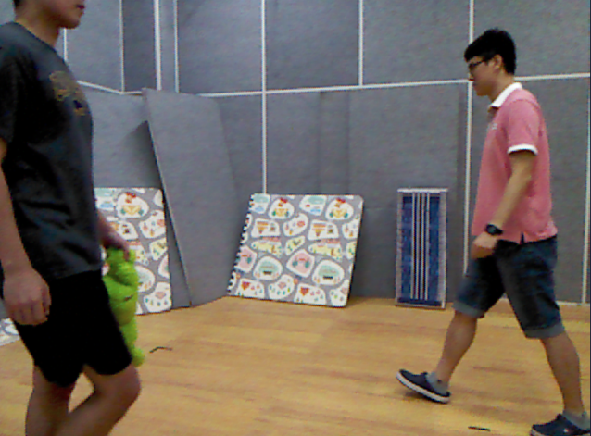
Motivation
Reconstructing the scene appearance can be ill-posed given small number of input views
→ more images (c.a 50 per scene)
→ time-consuming to train (c.a 10h)
Most of the scene is empty
→ sampling from median uniform density is
inefficient
1. More images increase rendering quality but also training time (c.a 12h for 50 images)
2. Most of the scene is empty
Sampling from median uniform
density is inefficient
3. Non-rigid real world data
Minimal texture
Less image overlap
Notes:
Motivation
During training NeRF is always optimized for one scene and has to find correspondence of RGB values accross different views
The optimization problem is undeconstraint and hard to optimize
Results get better by adding more data but this also increases training time
Training time on single GPU c.a 12h for 50 images for one scene
Training time also depends on the sampling strategy
Usually sampling from median uniform density is used which is inefficent because most of the scene is empty
Non-rigid real world data is more challenging than artificially created dataset without background
Regions with minimal texture
Illumination and contrast changes between fews --> less overlap in images --> harder to optimize

Slide 4



Goals
Reconstructing the scene appearance can be ill-posed given small number of input views
→ more images (c.a 50 per scene)
→ time-consuming to train (c.a 10h)
Most of the scene is empty
→ sampling from median uniform density is
inefficient
1. Synthesize novel views from real world scenarios
2. Improve data efficiency
3. Reduce training time
Notes:
Goals
Synthesize novel views from real world scenarios
Improve data efficiency
Reduce training time

Slide 5
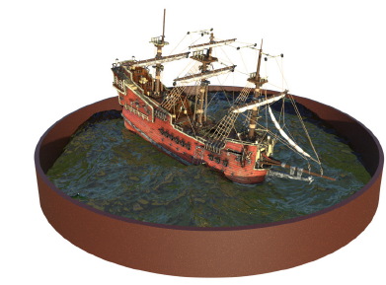
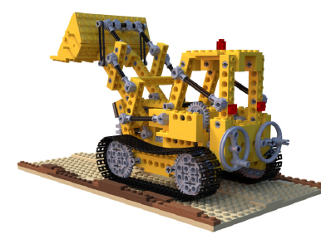
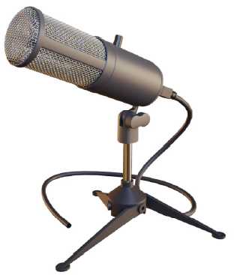
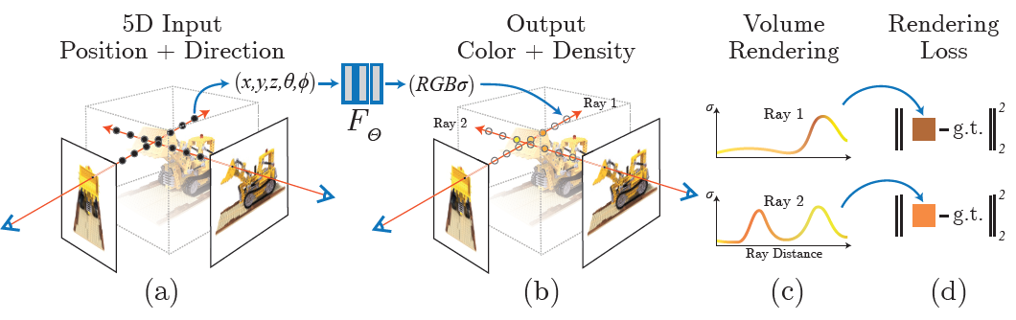
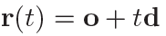
NeRF
Rigid object data
5D coordinates are sampled along camera rays (positional encoding + hierarchical volume sampling)
MLP produces color and volume density for each sample
Samples can be transformed into an image with volume rendering
Optimization via minimizing the residual between synthesized and ground truth observed image
Method
Results
Density
Colour
Transmittance = probability of not hitting any particle
Notes:
NeRF
Then a short overview of the methods our work is based on
First of all we have the Origina NeRF paper
The method uses scenes with rigid objects like the boat of microphone
The method consists of four steps:
You have images from a 3D dimensional static scene
You cast rays through the scene from which points are sampled
The position of points is determined by the origin and the viewing angles which results in a 5D vecor
Vector is encoded with positional encoding (similar to transformer they use trigonometric functions) and passed through the network which returns the colour of each sample and a density value (can be seen as differential opacity controlling the amount of radiance that is emitted by the sample)
You apply volumen rendering over the ray (which is like a weighted averag) and then compare the resulting color with the rendering loss
Process is fully differentiable and can be optimized with backpropagation
Below two example results of a optimzed NeRF model

Slide 6
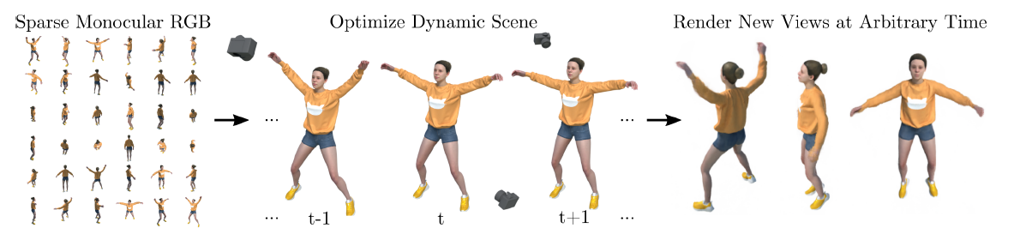
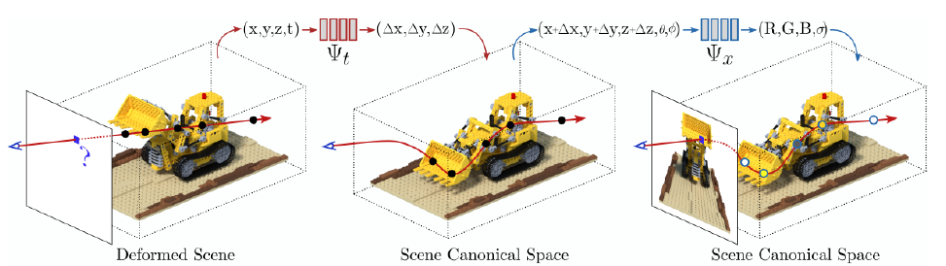
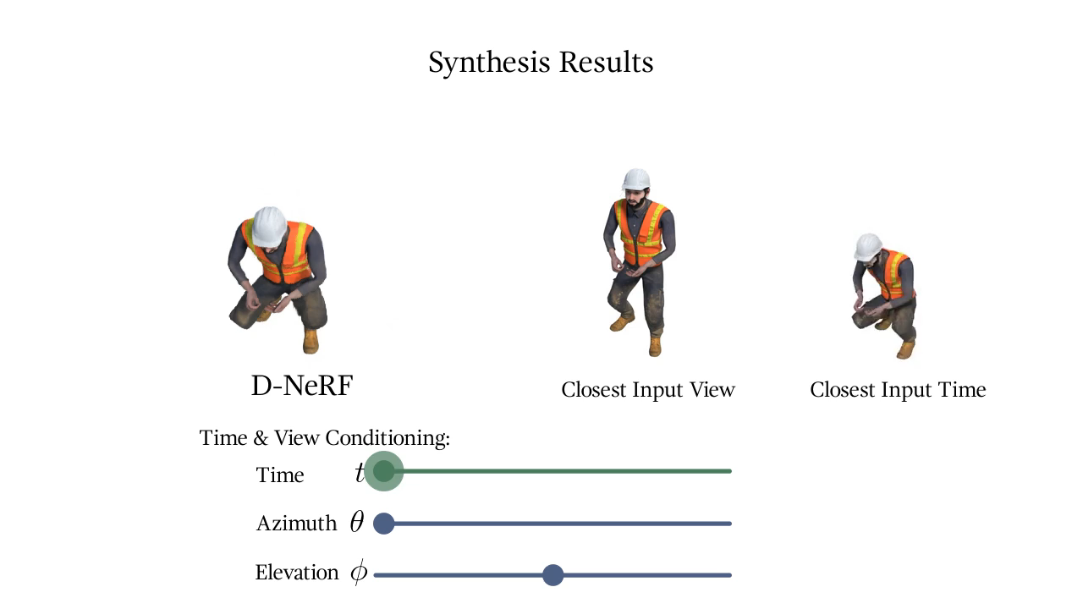
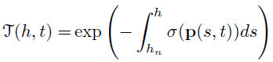
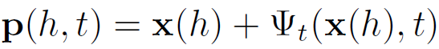
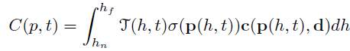
D-NeRF
Non rigid data
Method
Results
Deformation Ntwork
Canonical Network
Notes:
D-Nerf
Dynamic NeRF paper (D-NeRF)
Introduces a method for handling dynamic scenes
Approach is similar to original NeRF paper but they added an additional Network that considers the non-rigidity of the scene
Deformation network projects point into canonical space, which consider deformation of scene,
The output of the model is delta translation of each sample in x, y, z direction
The results are then passed to the canonical network that does the rendering
Then the synthesized results look like this

Slide 7
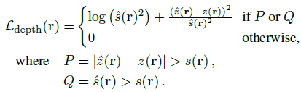
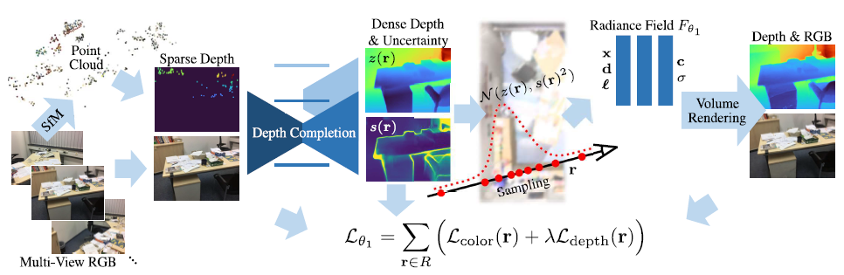
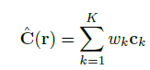
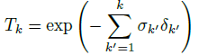
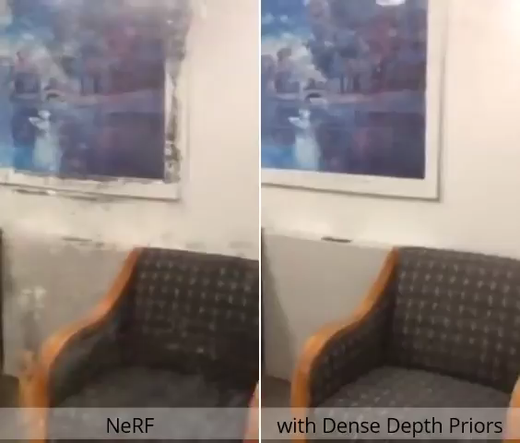
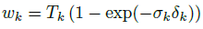
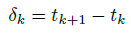
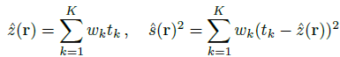
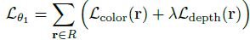
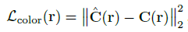
Dense Depth Priors for NeRFs
Static indoor data
Method
Method
Results
Transmittance
Rendering weights
Depth estimation
Uncertainty estimation
Notes:
Dense Depth Priors for NeRFs
The approach focuses on static indoor scenes and uses depth supervision to guide the optimization process
1. First of all they get sparse depth data from structure from motion preprocessing --> used to estimate camera intrinsics
2. A depth completion model is applied to get dense depth maps + uncertainty estimates
3. Depth information is then used for depth supervised sampling and an additional term in the loss function that guides NeRF optimization process
Training is more efficient with depth supervision

Slide 8
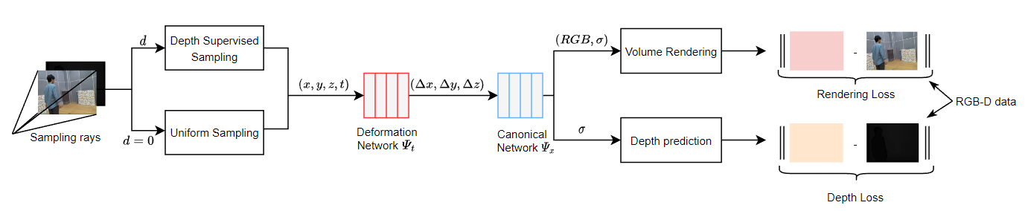
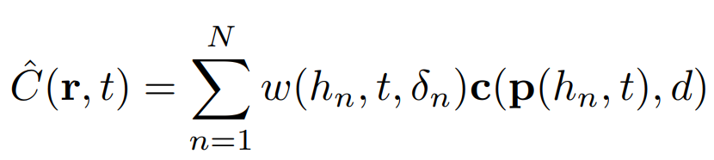
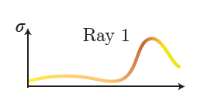
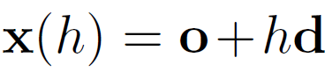
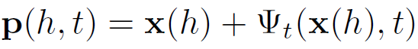
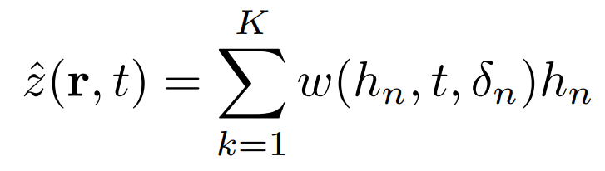
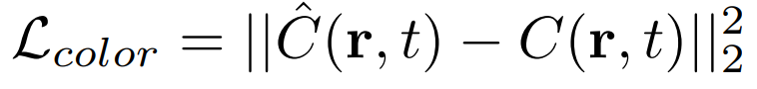
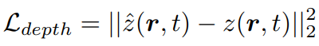
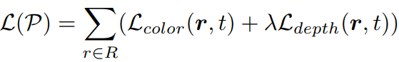
Method
Ray Sampling and Transformation
Volume Rendering
Rendering weights
Color of sample
Depth prediction
Loss

Slide 9
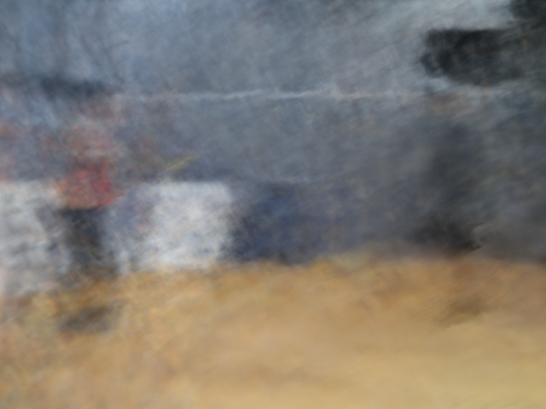
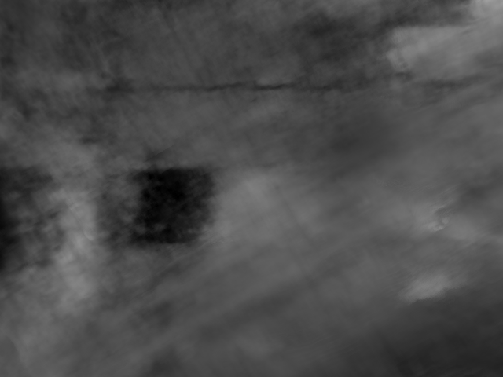
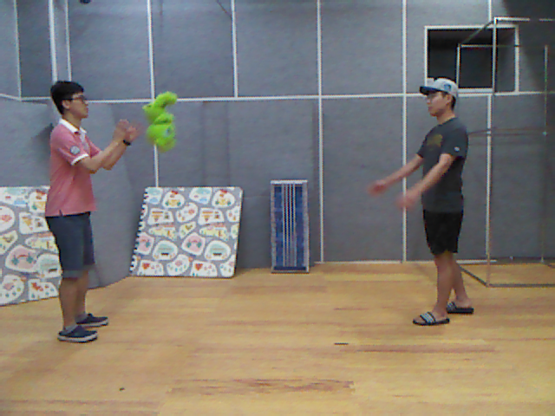

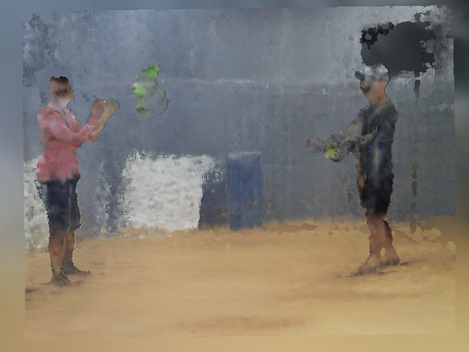
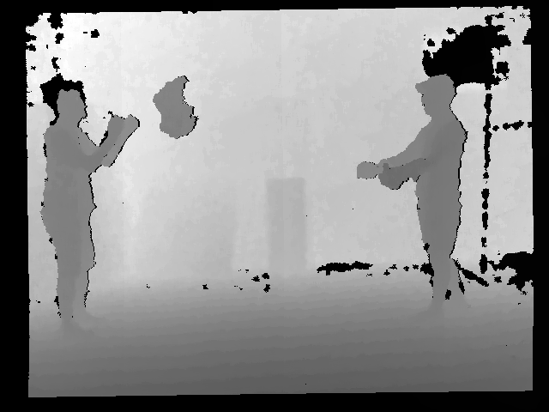
Intermediate Results
We trained both methods for 50 epochs
The D-NeRF baseline without depth supervision
Ground truth
Our method with depth supervision
Metrics:
PSNR↑ LPIPS↓ SSIM↑ RMSE↓
20.34 0.6326 0.5968 -
21.54 0.5735 0.6173 0.3841
w/o
with

Slide 10
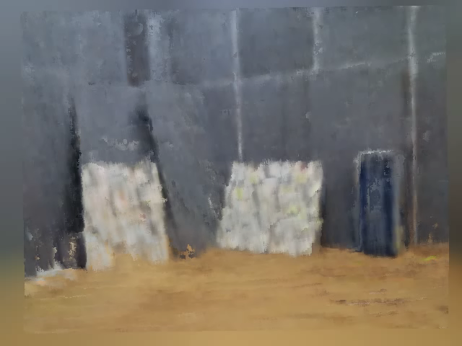
Current Issues
1. The color output is still very blurry, details are lost
2. For areas, where we only perform uniform sampling, method fails
3. For dynamic parts, the performance is also very poor

Slide 11
Conclusion
Depth supervision & sampling improves the depth prediction
Depth supervision & sampling improves color prediction (but still blurry)
Next steps
Debug the implementation to find what cause the issues
Tune architecture of canonical and deformation network (more layers)
Test different or complicated depth loss function
Ours
D-NeRF baseline
Ground truth

Slide 12
Thank you for your attention!
Chang Luo, Robin Falter
Technische Universität München
30. November 2022

Slide 13
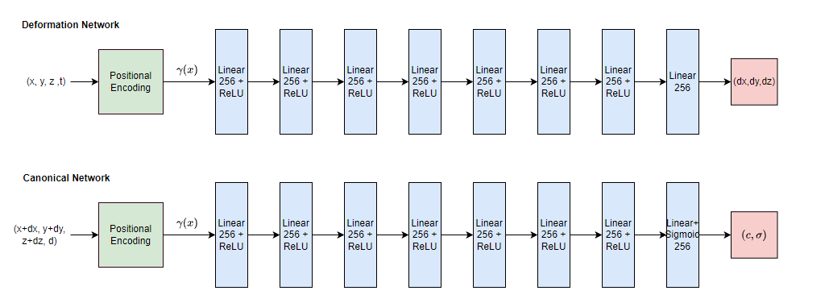
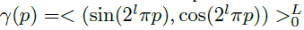
Network Architecture
L=10 for x
L=4 for d, t
34 input dims for Deformation Network
38 input dims fo Canonical Network

Slide 14
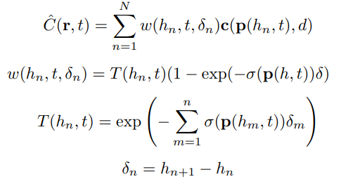
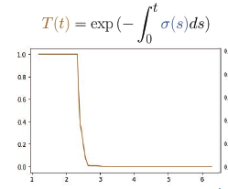
Rendering Weights Calculation

